Slide 1

Athena CredXpert
…Unlocking India’s True Credit Potential

Slide 2


India’s Silent Credit Crisis
Credit Scores are shaping financial futures, yet most Individuals are not aware of their score.
Current Reality
Hidden Impact
79% of approved loans go to Individuals with a Credit Score of 750+
Individuals with lower scores are excluded or charged a higher interest
68% of Individuals do not know their Credit Score
Credit Scores continuously drop without the Individual knowing
76% do not know the interest rate on their loans
Poor credit behavior goes completely unnoticed
Source: ETBFSI, CIBIL Blog, Mirae Asset Finance

Slide 3
The Hidden Struggle of Non-Individuals
Non-Individuals depend on credit for survival and growth. Most Non-Individuals are not aware that they have a Credit Report or a Credit Rank.
Current Reality
Hidden Impact
Non-Individual Credit Reports are rarely monitored
Errors or misreporting quietly damage credibility with lenders
Most Non-Individuals are unaware of how their credit profile is evaluated
They end up paying higher interest or losing out on cheaper funds
Weak credit health goes unchecked in daily operations
Over time, this can block access to formal credit for survival and growth

Slide 4


Consequence of Low Credit Scores and Ranks
For Individuals
For Non-Individuals
Loan or credit card rejections
Higher borrowing costs
Approvals with higher interest rates
Reduced credit limits on working capital loans and overdraft facilities
Limited access to affordable credit, affecting major life goals (home, education, marriage)
Increased demand for collateral and personal guarantee
Job opportunities lost due to employer credit checks
Cash flow constraints slowing business expansion
Increased financial stress
Disqualification for tenders or contracts requiring strong credit standing

Slide 5
Why Lenders Lose Eligible Customers?
Most customers walk in unprepared with unresolved credit issues causing lenders to reject customers who could have been approved with the right guidance.
Current Reality
Hidden Impact
A large segment of customers are denied credit solely because their Credit Scores are low
Lenders lose good customers whose scores could be improved with the right guidance
Customers are unaware, unprepared and often apply with unresolved credit issues
Lenders spend time on cases that end up rejected, increasing TAT and lowering productivity
Rejected customers move to lenders with higher risk appetite
Lenders lose potential customers to competitors and miss long-term retention opportunities

Slide 6




The Vicious Cycle
Low Credit Scores / Ranks set off a vicious cycle, for Individuals and Non-Individuals alike, that keeps worsening over time.
Loan Application Rejection
Low Credit Score / Rank
Missed Payments
Reduced Access to Funds
Credit Stress

Slide 7




The Credit Ecosystem - Where Athena CredXpert Adds Value
In today’s credit ecosystem, borrowers lack a trusted partner to help explain their Credit Reports, spot errors and guide them in credit improvement.
Loan Approved
Positive
This is where we come in
Loan Rejected
Negative
Credit Report
Loan Application
Enquiry
Borrowers
Banks/NBFCs/ HFCs/Other Lenders
Credit Bureaus

Slide 8
Athena CredXpert - One-Stop Solution for All!
We provide personalized Credit Repair services tailored to one’s unique situation empowering them to unlock better financial opportunities.
At Athena CredXpert, we navigate credit complexities such as:
Difficulty in understanding your Credit Report
Low Credit Score/ Rank limiting access to credit
Loan or credit card rejections impacting financial goals
Errors and inaccuracies negatively affecting Credit Reports
Identity theft or fraudulent activity impacting your financial security

Slide 9



Our Services
Personalized credit repair solutions offer a tailored approach to help Individuals and Non-Individuals enhance their creditworthiness, enabling better access to credit.
Repair
We analyse your Credit Report, identify the issues and provide you with a clear, step-by-step plan to repair your credit. You receive all the guidance and tools needed to confidently improve your credit.
Repair +
All the benefits of Repair, plus we take on the effort of communicating with lenders and Credit Bureaus, disputing errors and managing the credit repair process on your behalf.
Credit Pulse
Upload your Credit Report and get a quick, easy-to-understand analysis highlighting red flags affecting your Credit Score and specific recommendations - helping you stay informed about your credit health.

Slide 10
Repair and Repair + (Individuals/Non-Individuals)
 | Repair | Repair+
Offers customised guidance | P | P
Analyse & comprehend current credit health | P | P
Provide practical advice for decision making | P | P
Raise disputes with Credit Bureaus on behalf of the client | O | P
Facilitate the preparation of all required communications and documentation to lenders and Credit Bureaus on behalf of the client | O | P
Follow-up throughout the process | O | P
Report Insights & Recommendations Report | P | P
Provide on-going support when needed | P | P
Provide client-centric strategies | P | P

Slide 11





A quick and intelligent scan of an Individual’s Credit Report that reveals what is hurting their Credit Score and how to fix it.
Instant Analysis
Upload a Credit Report and receive results within minutes.
Red Flag Detection
Identifies errors, missed payments, high credit utilization and other factors pulling the Credit Score down.
Targeted Recommendations
Delivers clear, specific actions to address each issue.
Easy To Understand
Simplifies complex credit data into plain and actionable insights.

Slide 12



Why Us ?
Expertise
With 30+ years of combined experience, our team delivers expert guidance grounded in proven Credit Repair and Credit Score/Rank improvement success.
Personalized Solutions
Every Credit Report and goal is unique; we tailor strategies to fit individual circumstances and objectives.
Transparency
Clear, honest communication with full disclosure and regular updates throughout the process - no hidden steps.
Result-Driven Approach
Focused on real and measurable improvements that enhance credit health and help achieve financial goals.

Slide 13

Who We Are?
“Do right, Do it right and Do what is right - best describes our stated goal. Athena CredXpert is a natural extension of my professional story.”
Former Managing Director of CIBIL and the President (Financial Infrastructure and Credit Bureaus) of Dun &Bradstreet- South Asia ,Middle East &Africa where he headed the team to build Credit Bureaus and develop credit scores in India & countries like UAE, Egypt, Sri Lanka & Bhutan.
Satish Mehta Founder & CEO

Slide 14
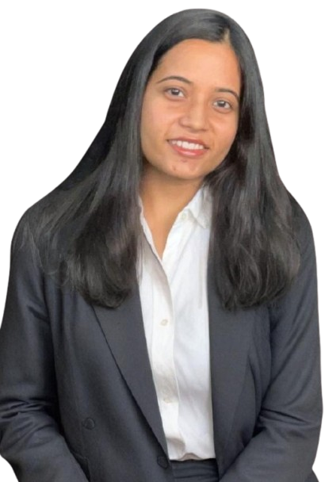
Who We Are?
“Driven by the commitment to excellence and to delivering results, has led to the foundation of Athena CredXpert”
Having gained years of experience in the field of Credit Information and Housing Finance, she strongly recognizes the need to improve the credit culture of Indians by giving them a helping hand on all aspects.
Mitushi Chaurasia Co-Founder & COO

Slide 15
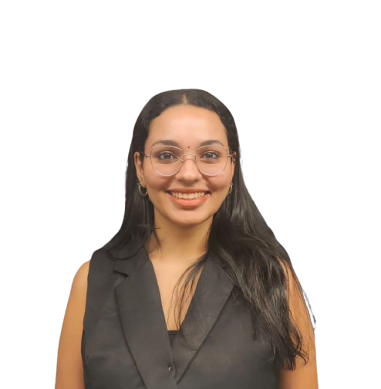
Our Team
“Value is created when solutions meet needs before they become problems.”
Starting her professional journey with Athena CredXpert, she has been actively involved in developing and shaping product design, processes and policies and supporting the setup of the IT infrastructure.
Sameeksha Shetty Associate

Slide 16
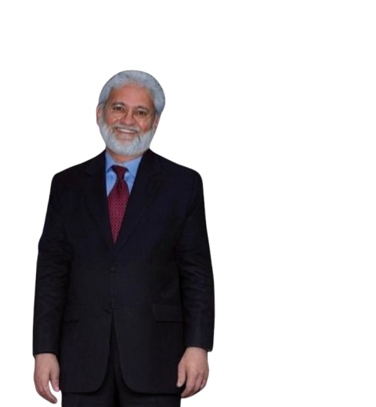
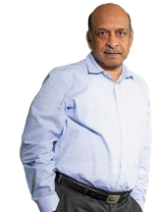



Our Advisory Board
Anil Mehta
Chairman & Non-Executive Director at India Shelter Finance Corporation
Sudhin Choksey
Independent Director at Catholic Syrian Bank
Suneel Gautam
Founder of Clea Public Relations, Founder of Hanmer & Partners, Co-founder of Pitchfork Partners
Amit Badiyani
Founder & CEO of Harrier Information Systems
Bhavesh Vora
MD & CEO of SERNET Financial Services

Slide 17


Partnership with Harrier Information Systems Private Limited
We have partnered with Harrier Information Systems to unlock synergies and drive innovation, delivering faster, smarter and seamless solutions for our clients.
Athena CredXpert
Harrier Information Systems Private Limited

Slide 18









We Got Featured !

Slide 19





Contact Us
Satish Mehta
Founder & CEO
Mitushi Chaurasia
Co-Founder & COO
Sameeksha Shetty
Associate
satish@athenacredxpert.com
Mobile: +91 98201 23560
mitushi@athenacredxpert.com
Mobile: +91 97022 34065
sameeksha@athenacredxpert.com
Mobile: +91 77965 63762
https://athenacredxpert.com
212, Maker Chamber V,
Nariman Point, Mumbai – 400021, India
2nd floor, WeWork, Express Towers, Nariman Point, Mumbai – 400021, India
Reach us on

Slide 20

THANK YOU

